Slide 1

BD Online job Protocol
Name: Abul Hasnat Sobuj
Organization: IT Way BD
Summer: 2025
ID: 1922062

Slide 2
Project Overview
Web-based recruitment platform connecting job seekers and employers
Includes features such as job posting, resume upload, and admin verification..
Supports multi-language accessibility (English & Bangla).

Slide 3
Technology Uses.
PHP
My SQL
Development Tools: Visual Studio Code, GitHub
Javascript
bootstrap
CSS

Slide 4
My contribution
UI/UX Design & Frontend Development
Designed a responsive and interactive interface using Bootstrap and CSS.
Feature Implementation
Developed core modules such as job posting, resume upload, authentication system, and admin dashboard
Performance Optimization & Security
Optimized database queries, improved system speed, and implemented input validation, password hashing, and data encryption for secure and efficient performance.

Slide 5
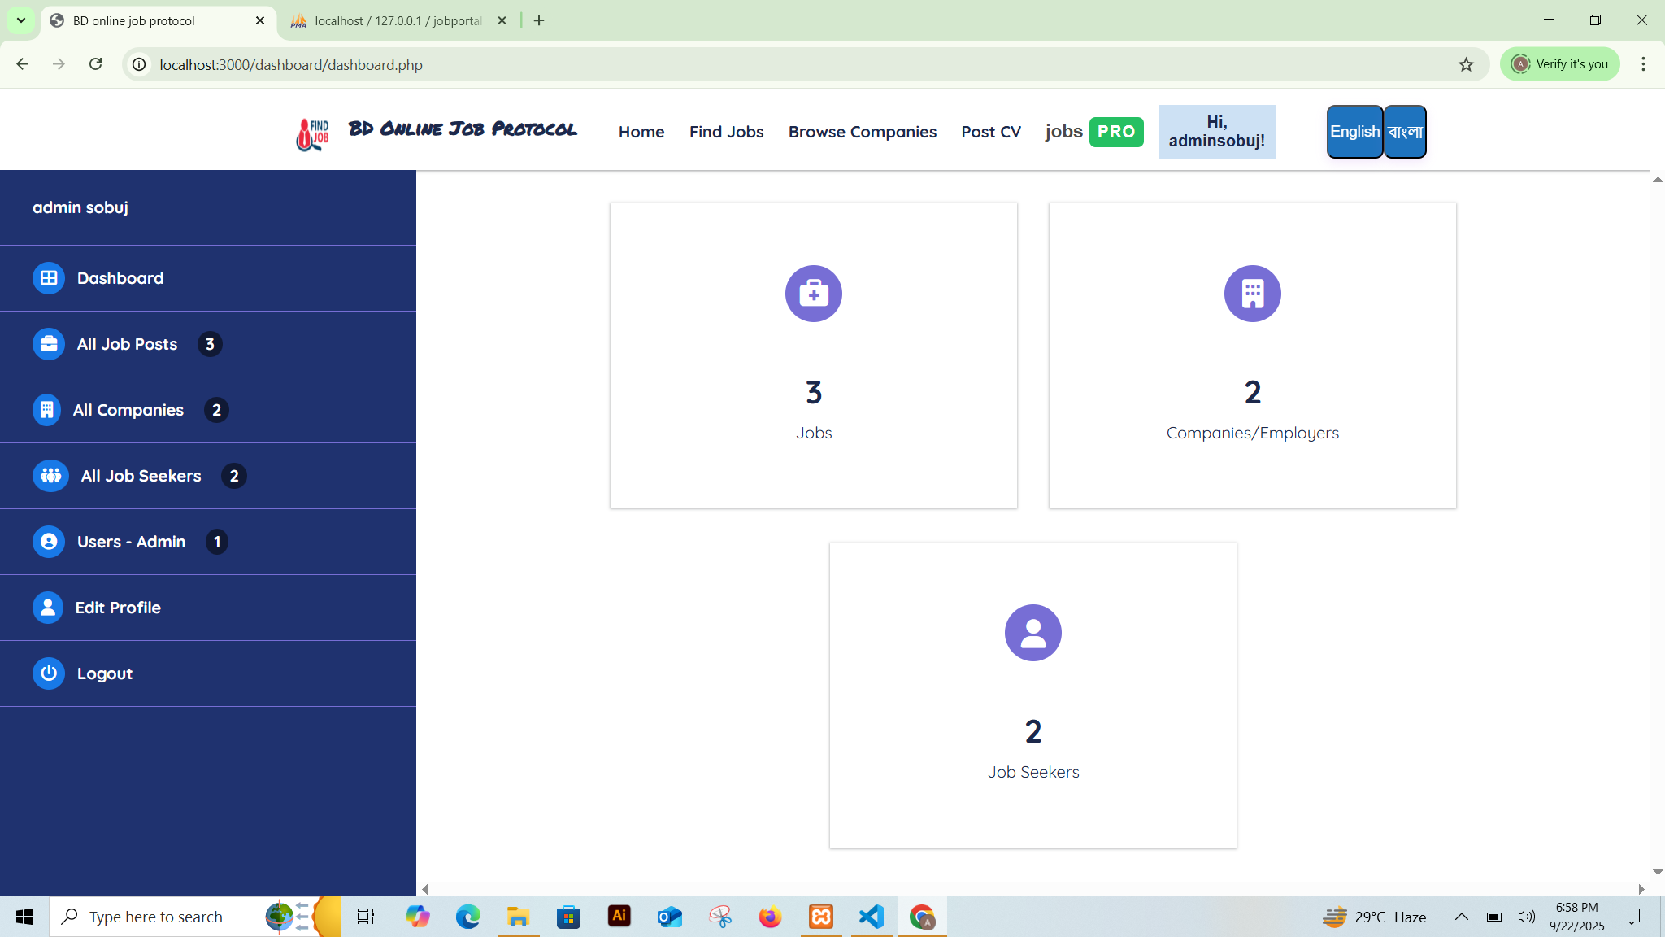
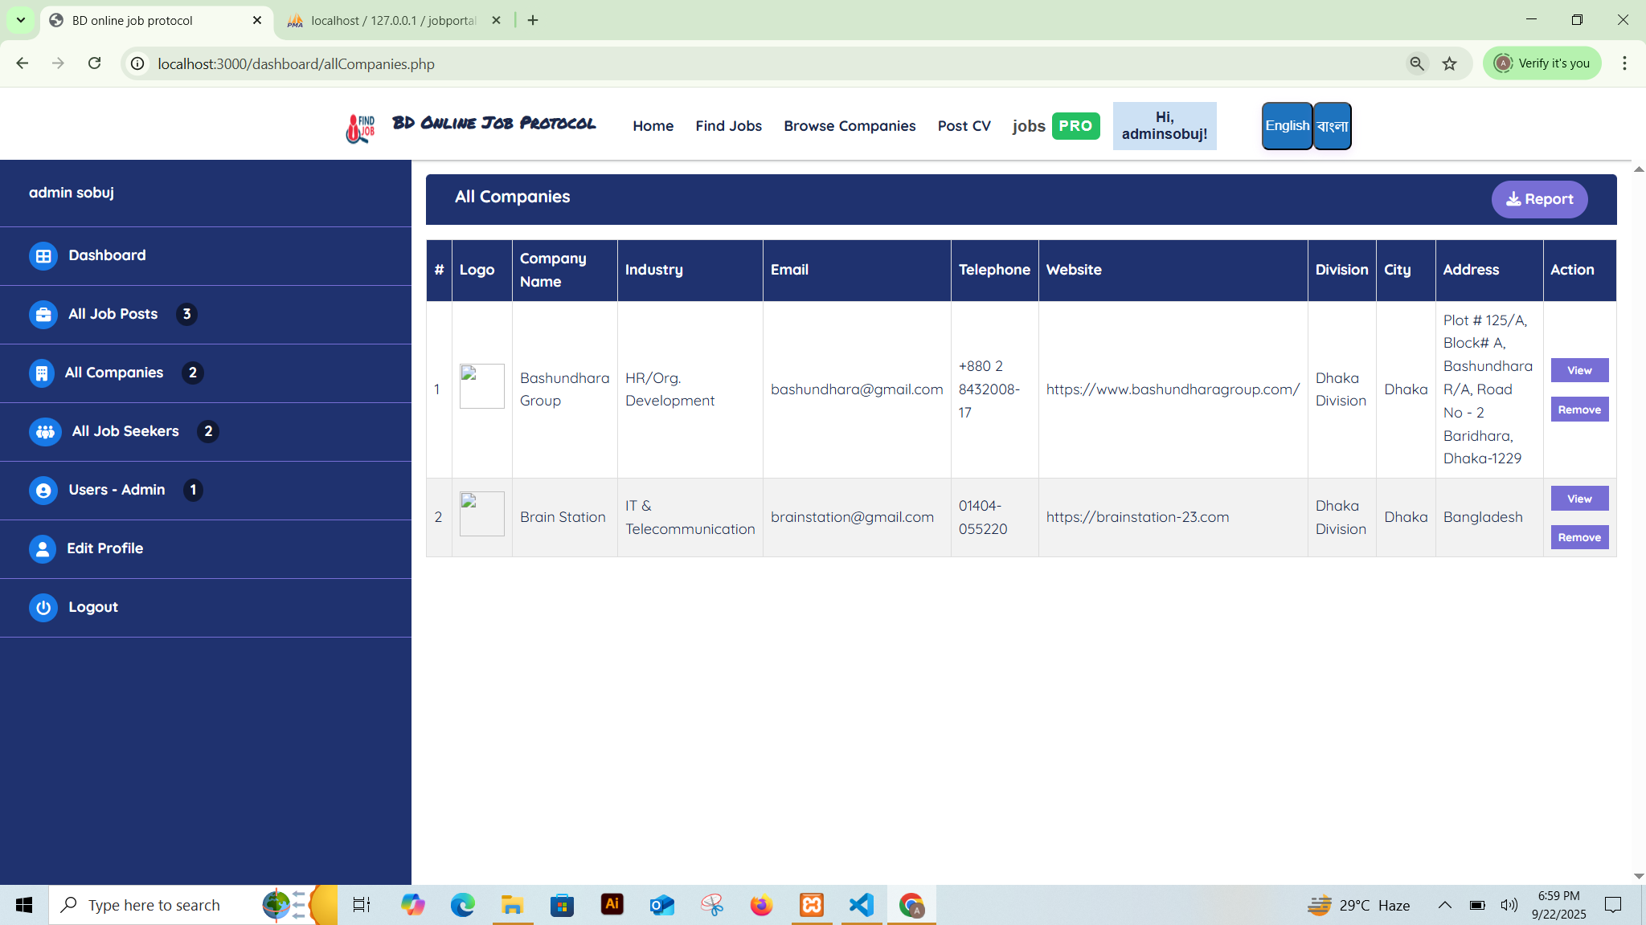
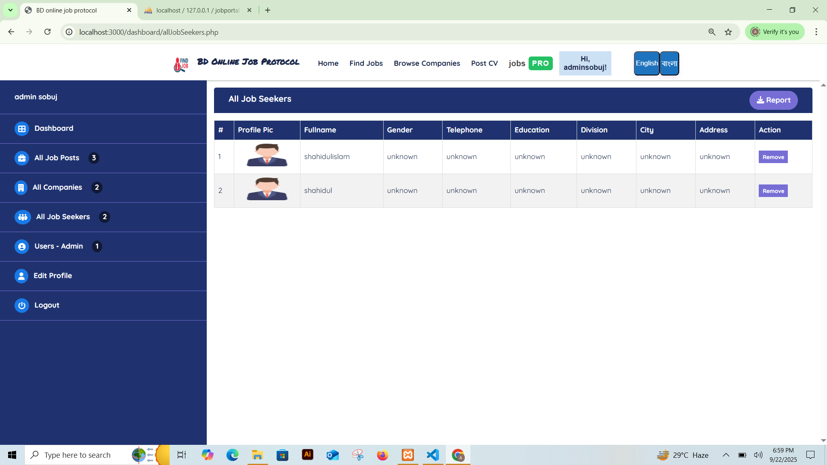
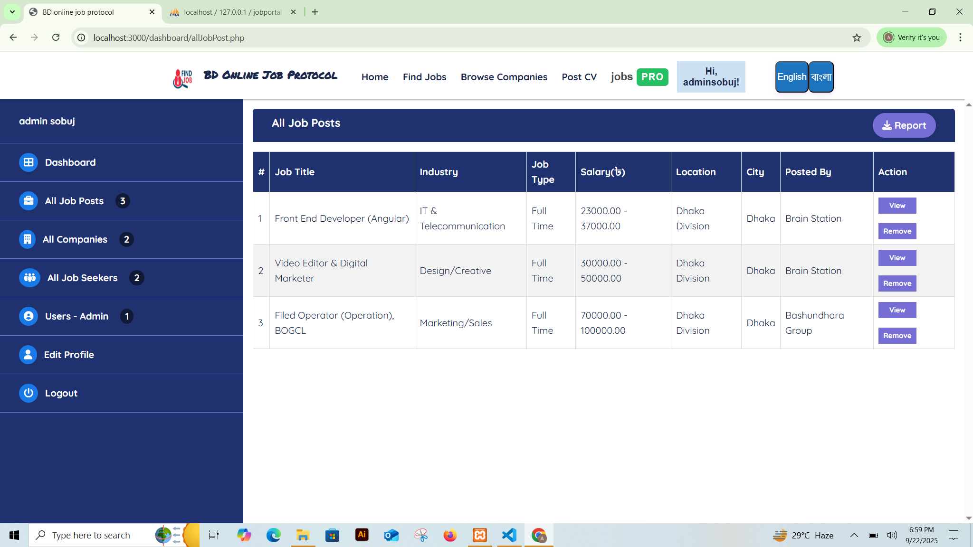
Admin Dashboard

Slide 6
What Technology Learn.
PHP
JavaScript
version control using Git for collaborative development
Component-Based Architecture

Slide 7
Methodology​
SDLC
Followed an iterative development approach
Frequent testing and user feedback incorporated into updates.
Version control and collaboration via GitHub.
Automated testing and code reviews to ensure code quality.

Slide 8





Future Works
Integrate AI for smart candidate-job matching.
Add blockchain-based credential verification
Implement virtual interview tools and video conferencing.
Expand analytics dashboard for market insights.

Slide 9
THANK YOU
Abul Hasnat Sobuj
1922062
1922062@iub.edu.bd

